Slide 1
Migration Training- Day 1

Slide 2
Agenda
Migration and Modernization
Why Cloud Migration is Needed?
Right Migration Strategy?
Monolithic and Microservices
Repo Migration
How to Migrate Programming Language?
How to Upgrade Web Framework?
AWS SDK Migration

Slide 3

Migration & Modernization

Slide 4
What is Cloud Migration?
Cloud Migration is the process of moving digital assets, such as applications, data, and workloads, from on-premises systems to the cloud.
Key Objectives behind migration:
Cost Savings: Reduce capital expenses by moving to a pay-as-you-go model.
Scalability: Access to scalable resources without hardware constraints.
Disaster Recovery: Improve disaster recovery and business continuity.

Slide 5
What is Cloud Modernization?
Cloud Modernization is the process of enhancing and updating IT systems to leverage cloud technologies. It involves moving from legacy systems to cloud-based environments to improve operational efficiency, scalability, and performance.
Objectives:
Enhance Flexibility: Adapt quickly to changing business requirements.
Improve Performance: Utilize cloud-native technologies for better speed and efficiency.
Future-Proof IT: Ensure systems are up-to-date with the latest technological advancements.

Slide 6
Why Cloud Modernization is needed?
Agility: Traditional IT systems can be rigid and slow to adapt. Cloud technologies offer greater agility, enabling rapid deployment and modification of resources.
Cost Efficiency: Cloud computing allows for a shift from large capital investments(CapEx) in hardware to more predictable operational expenses(OpEx). This pay-as-you-go model can reduce overall IT costs.
Innovation: Access to advanced technologies like AI, machine learning, and big data analytics which are often embedded in cloud platforms, fosters innovation and new capabilities.
Scalability: Cloud environments provide the ability to easily scale resources up or down based on demand, ensuring optimal performance and cost management.

Slide 7
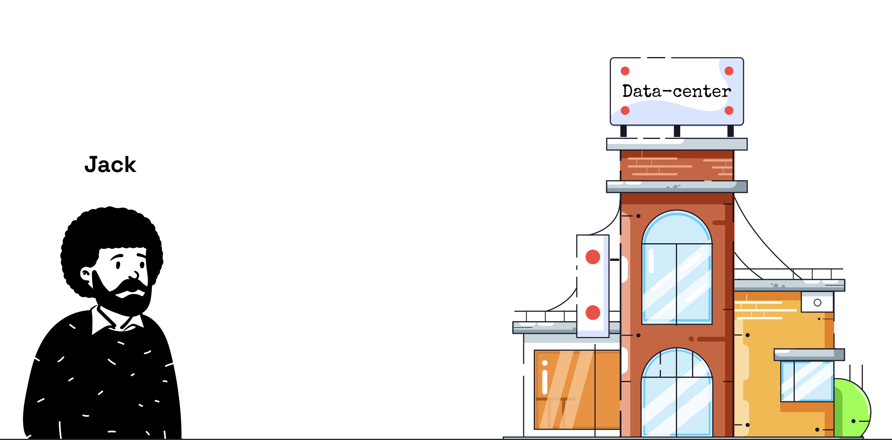
Jack has workloads in DC, he wants to reduce cost and increase sclability, what should he do?

Slide 8
When to choose what, Modernization or Migration?
The most important starting point to making the migration vs modernization decision is to understand the age and maintainability of the legacy system into account when putting together a modernization strategy.
Migrating a legacy system involves taking your old infrastructure and transferring it to the cloud. This does provide potential cost and efficiency benefits. However, it fails to give your application a growth perspective. The big picture vision that can take your business to a different level is missing from this option.
However, for small scale businesses, cloud migration can work wonders as the resources are limited. The important part is that you involve all your business units in the process to be prepared for the impact this change will have.

Slide 9
What’s the right Cloud Migration Strategy?
To migrate an application means to simply ‘Lift and Shift’. To modernize an application further means breaking down the application to pieces and then taking each part and building it to gain efficiencies & reduce costs.
Today, major cloud adoption trends include the following:
Cloud Migration of Applications
Migrate & Modernize business applications
Enabling Multi-cloud with the optimum cloud platform choices
This takes us to famous analogy “AWS 6Rs”, so lets see them in detail in next slide.

Slide 10
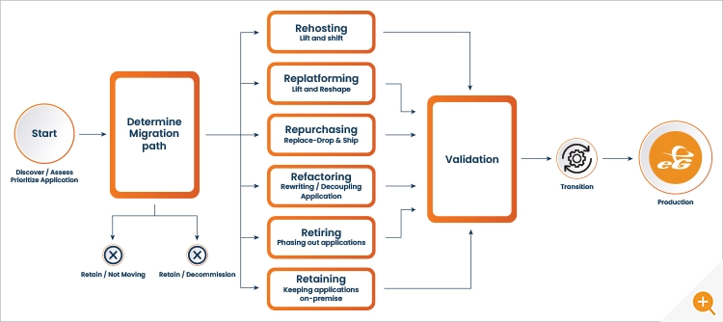
6 R’s in AWS (which now is 7Rs)
In recent years those original 6Rs have been joined by a 7th:- Relocate
Article to refer

Slide 11
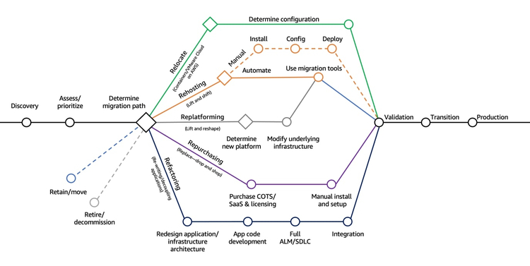
11

Slide 12
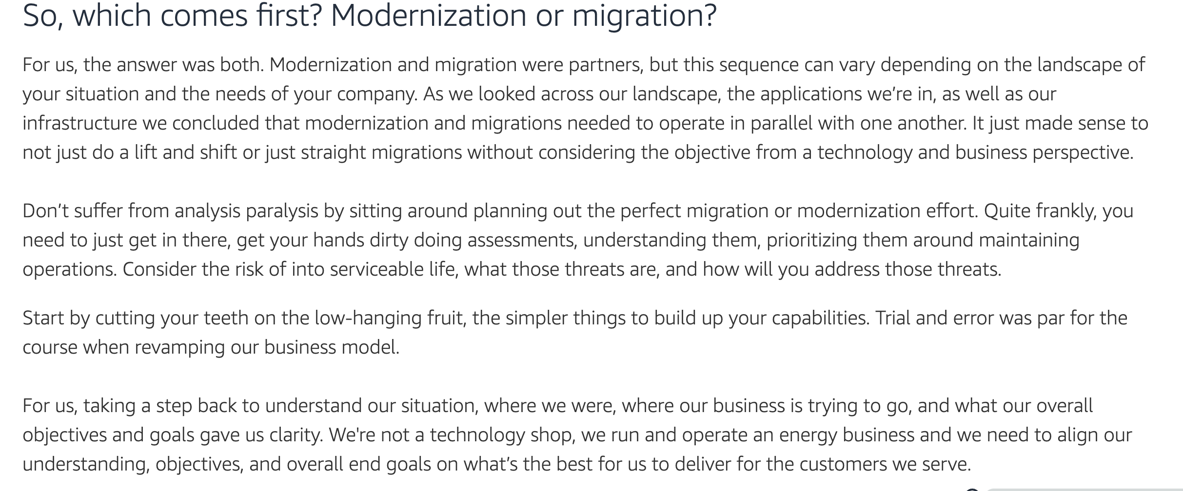
Article to refer - Case Study of BP
12

Slide 13
Phases of Migration

Slide 14
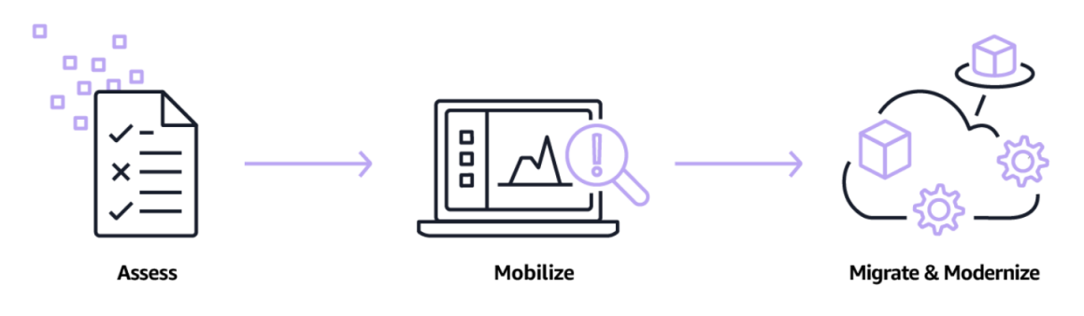
3 Phases of Migration (Assess, Mobilize, Migrate)
Assess
Mobilize
Migrate
Objective: Understand the existing IT landscape to make informed migration decisions.
Activities:
Inventory assets and dependencies.
Assess application performance and suitability for the cloud.
Evaluate security and compliance requirements.
TCO (Total Cost of Ownership) analysis.
Objective:
Prepare for the migration by creating a detailed migration plan.
Activities:
Define the migration strategy (rehost, re-platform, refactor).
Design the target architecture.
Set up a landing zone in the cloud.
Develop a migration schedule and communication plan.
Objective:
Execute the migration plan and transition to the cloud.
Activities:
Deploy necessary infrastructure in the cloud.
Migrate data, applications, and configurations.
Validate functionality and performance.
Implement monitoring and management tools.

Slide 15
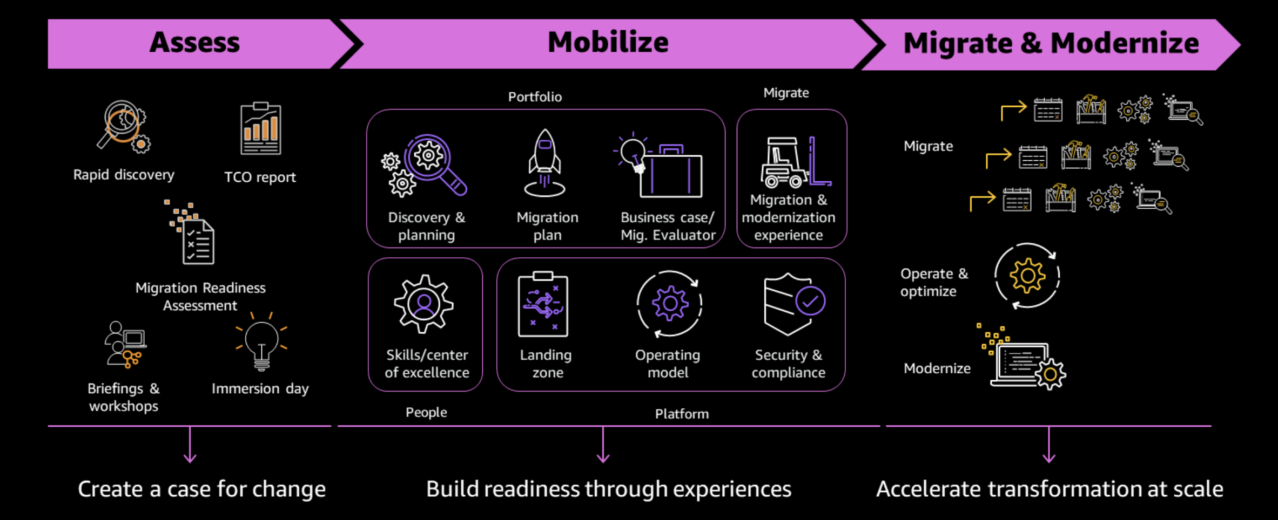
3 Phases of Migration (Assess, Mobilize, Migrate)

Slide 16
Monolithic vs Microservice

Slide 17
What is Monolithic Architecture?
A monolithic architecture is a traditional approach to designing software where an entire application is built as a single, indivisible unit. In this architecture, all the different components of the application, such as the user interface, business logic, and data access layer, are tightly integrated and deployed together.
This means that any changes or updates to the application require modifying and redeploying the entire monolith.
Monolithic architectures are often characterized by their simplicity and ease of development, especially for small to medium-sized applications.
However, they can become complex and difficult to maintain as the size and complexity of the application grow.
17

Slide 18
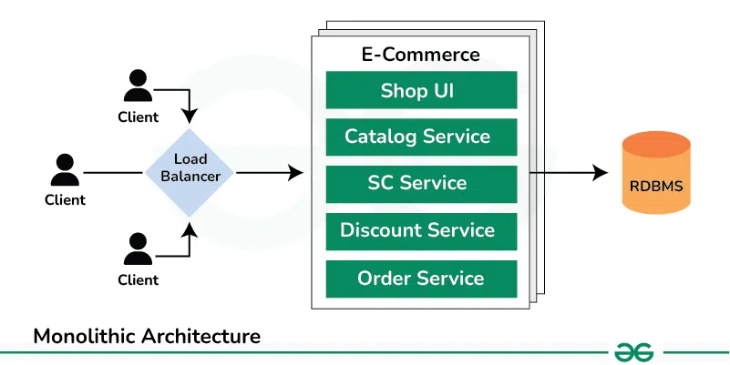
Monolithic Architecture

Slide 19
Advantages/Disadvantage of using a Monolithic Architecture
Advantages
Disadvantages
Simplicity → All the code for application is in one place. This makes it easier to understand how the different parts of the application work together.
Development Speed → Since all the parts of application are tightly integrated, it’s faster to develop new features.
Deployment → Simpler, only need to deploy one artifact. Easier to manage deployments and reduces the risk
Complexity → As a monolithic application grows, it becomes more complex and harder to manage.
Scalability→ All parts of the application are tightly coupled, scaling one component often requires scaling the entire application, which can be inefficient and costly.
Fault Tolerance → In monolithic architecture, there is no isolation between components, if a single component fails, it can bring down the entire application.

Slide 20
What is Microservice Architecture?
An application is built as a collection of small, independent services, each representing a specific business capability. These services are loosely coupled and communicate with each other over a network, often using lightweight protocols like HTTP or messaging queues.
Each service is responsible for a single functionality or feature of the application and can be developed, deployed, and scaled independently.
The Microservice architecture has a significant impact on the relationship between the application and the database.
Instead of sharing a single database with other microservices, each microservice has its own database.
20

Slide 21
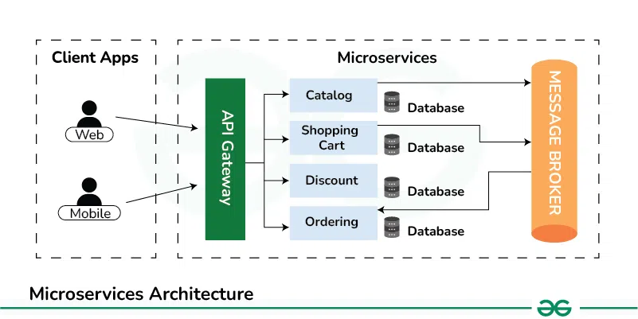
Microservice Architecture

Slide 22
Advantages/Disadvantage of using a Microservice Architecture
Advantages
Disadvantages
Simplicity → Individual components of application can be scaled independently based on demand
Flexibility: Enable teams to use different technologies and programming languages for diff. services based on their specific requirements.
Resilience: Microservices are decoupled from eachother, a failure in 1 service doesn’t necessarily impact the entire application.
Agility: Microservices enable teams to independently develop, test, deploy, and scale services, allowing for faster development
Complexity: Managing a large number of microservices can be complex.
Increased Overhead: There is overhead associated with managing the communication between services, such as network latency and serialization/deserialization of data.
Deployment Complexity: Deploying and managing a large number of microservices can be complex.
Monitoring and Debugging: Monitoring and debugging microservices can be more challenging, since each service is independent, tracing issues across multiple services can be complex.
22

Slide 23
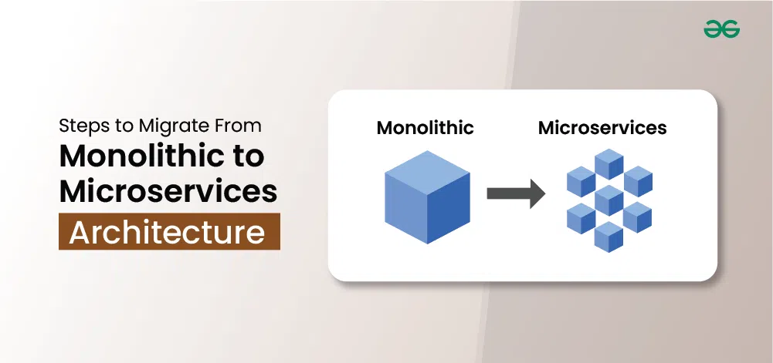
Migrate From Monolithic to Microservices Architecture
Moving from one big block of software to many smaller blocks might seem easy.

Slide 24
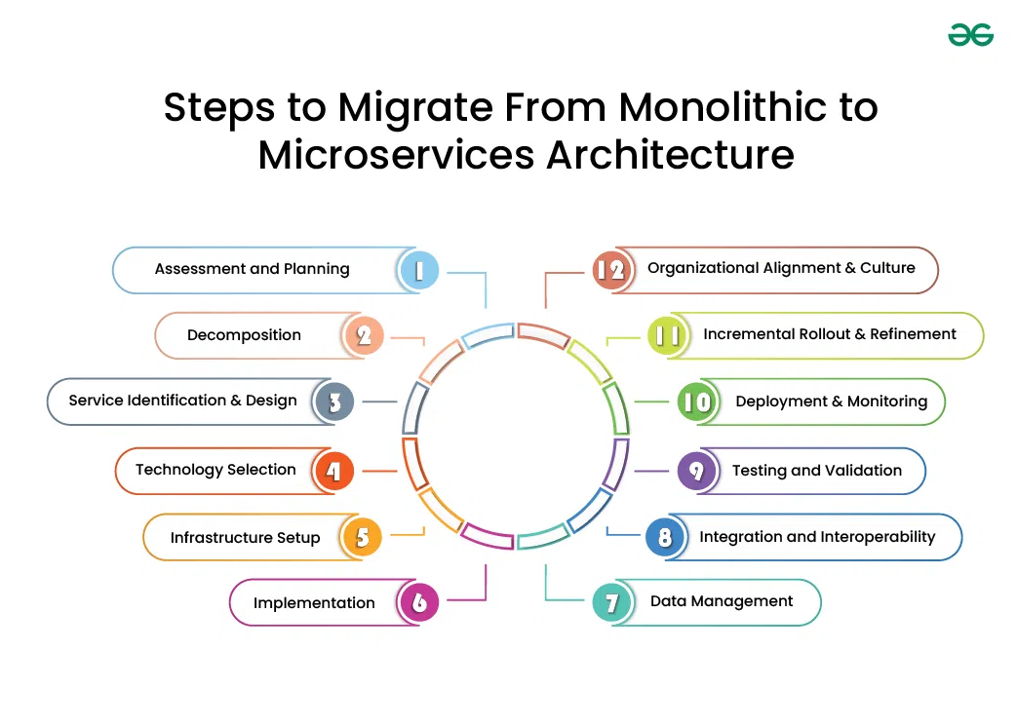
24

Slide 25
Repository Migration

Slide 26
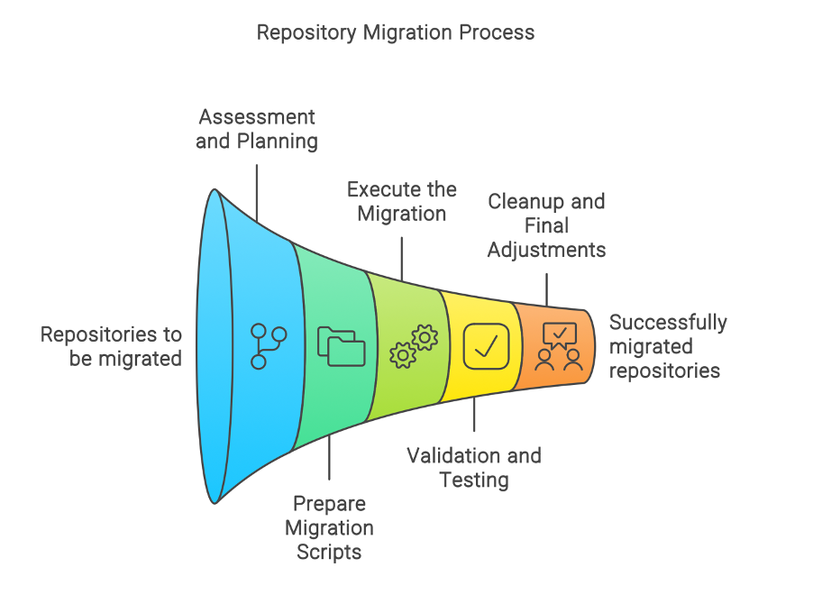
Repository Migration
As organizations grow and technology evolves, the need to migrate repositories becomes essential to maintain efficiency, security, and scalability. Repository migration is not just about moving code; it’s about transforming the way teams collaborate, manage, and deploy their projects.

Slide 27
Steps for Repository Migration
Assessment and Planning:
Evaluate the existing repository’s structure, size, and usage.
Identify dependencies, integrations, and potential challenges.
Analyze code complexity and version control history.
Prepare Migration Scripts or Tools:
Use scripts to automate cloning, mirroring, or pushing repositories to the new platform.
Ensure that scripts can handle exceptions and retries automatically.
Execute the Migration:
Run the migration in a test environment first.
Execute the migration scripts/tools.
Monitor the process for any errors or missed repositories.

Slide 28
Steps for Repository Migration
Validation and Testing:
Verify all repositories have been migrated correctly with complete history.
Validate that all branches and tags are correctly transferred.
Conduct build tests to ensure the repositories are functioning as expected in the new environment.
Cleanup and Final Adjustments:
Remove or archive old repositories if required.
Update documentation and CI/CD pipelines to point to the new repository locations.
Inform all stakeholders about the migration.

Slide 29
Automating Repository Migration

Slide 30
Automate Repository Migration using Tools
GitHub to GitLab: Use GitLab's built-in import tool which can import projects directly from GitHub using OAuth. For automation over multiple repositories, consider using GitLab API.
GitHub to Azure DevOps: Use the Azure DevOps Migration Tools, or write scripts that utilize Azure DevOps REST APIs to create new repos and push code from GitHub.
Open-source tools: Tools like gitlabber (for GitLab), or custom scripts using git commands can be used for bulk operations.
Example Scripts and Tools
Here's an example approach using a generic script for GitHub to GitLab migration.
Note:
This script would need a repositories.csv file with the names of all repositories to be migrated. Each repository would be cloned with all its data (including all branches and tags), and then pushed to the new GitLab instance.

Slide 31
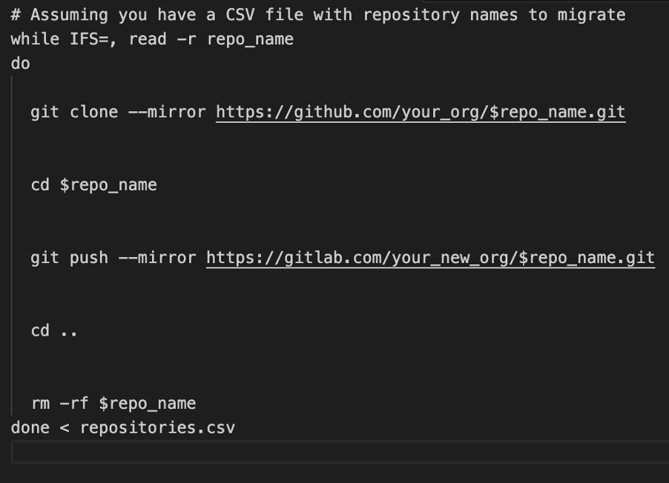
Other Repo Migration Example:
CodeCommit Repo Migration: https://aws.amazon.com/blogs/devops/how-to-migrate-your-aws-codecommit-repository-to-another-git-provider/

Slide 32
Real Case Scenario Repository Migration

Slide 33
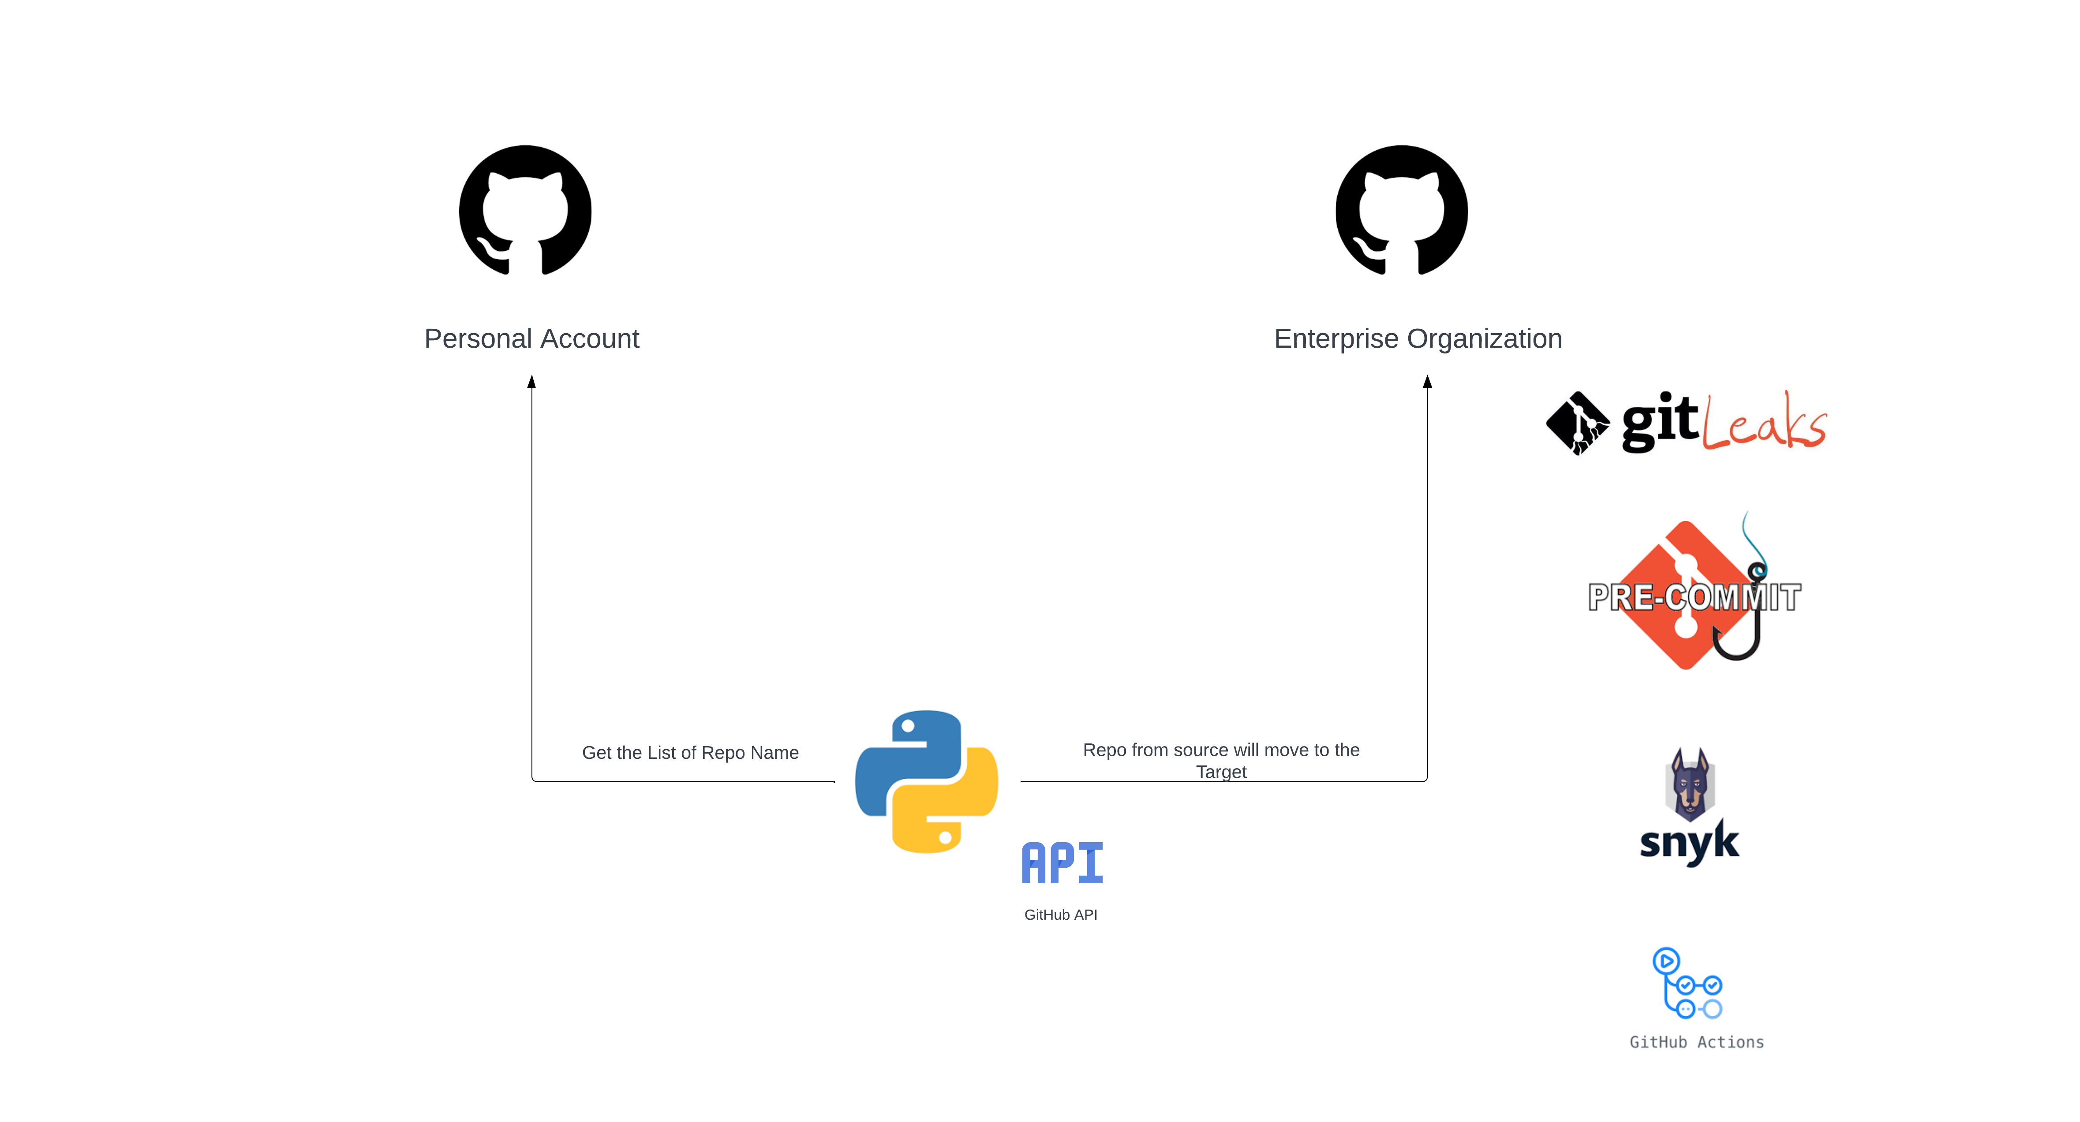
GitHub to GitHub Enterprise Migration

Slide 34
Programming Language Upgrade/Modernize

Slide 35
Programming Language Upgrade
Assessment
- Conduct a comprehensive review of your codebase and infrastructure to understand complexity,
dependencies, and potential challenges.
- Identify code complexity, assess third-party dependencies, and evaluate the impact on existing
integrations.
Prioritization
- Identify critical components that are essential for initial migration.
- Prioritize modules with minimal dependencies or external integrations.
- Consider starting with non-customer-facing functionalities to minimize disruption.
Selection of Tools and Techniques
- Explore automatic migration tools such as Py4J or Jython for converting Java code to Python.
- Utilize manual refactoring techniques for more complex code segments.

Slide 36
Programming Language Upgrade
Testing and Validation
- Develop a thorough testing strategy including unit, integration, and system testing to ensure functionality
- Implement CI/CD pipelines for continuous testing and validation.
Gradual Rollout and Monitoring
- Deploy the migrated codebase in stages, starting with less critical components.
- Monitor the system closely for any issues or performance bottlenecks.
- Iterate and improve based on feedback and observed behavior.

Slide 37
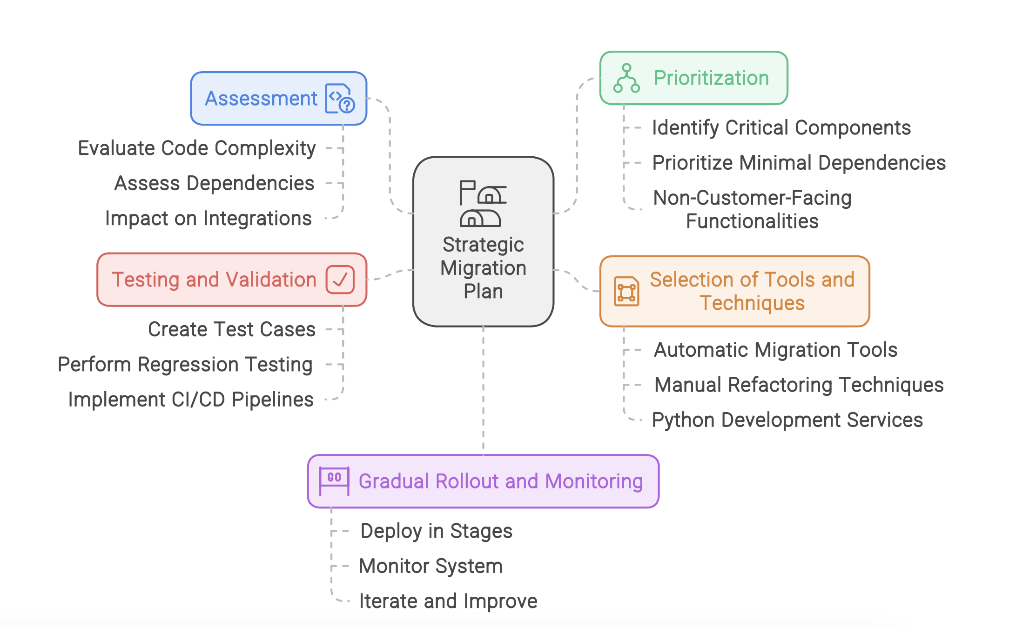
Steps Involved in a Strategic Upgrade Plan

Slide 38
Use Case: Java to Python Upgrade

Slide 39
Why Change from Java to Python?
Faster Development: Python’s concise syntax and extensive library support enable developers to write code faster than Java.
Cloud-Native Readiness: Python is well-suited for modern cloud-native architectures and DevOps practices, its flexibility and scalability make building and deploying microservices easier.
Data Science and AI Capabilities: Go-to language for data science, machine learning, and artificial intelligence. Libraries like NumPy, Pandas, and TensorFlow makes it easier to implement complex algorithms.

Slide 40
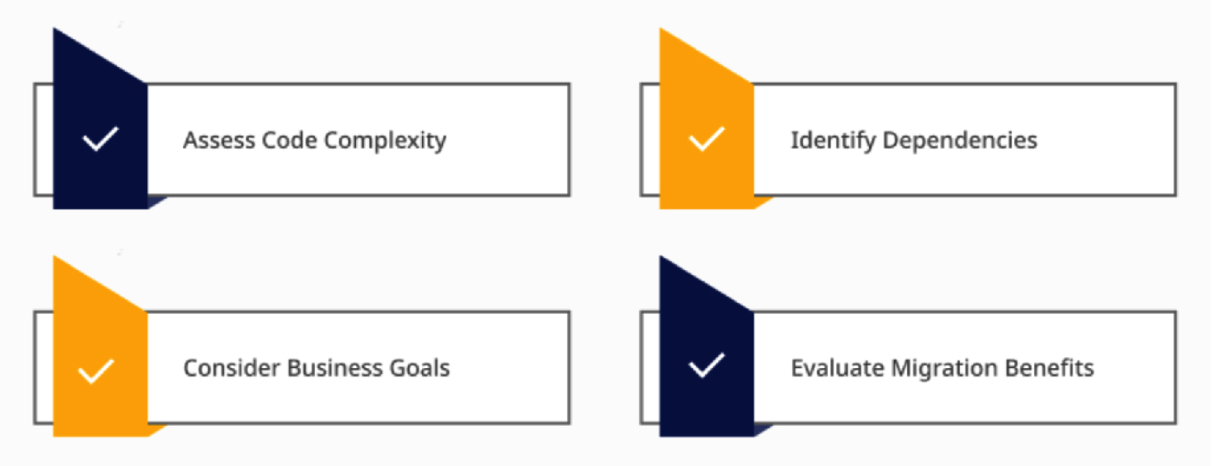
Is the Java App Ready for Python?

Slide 41
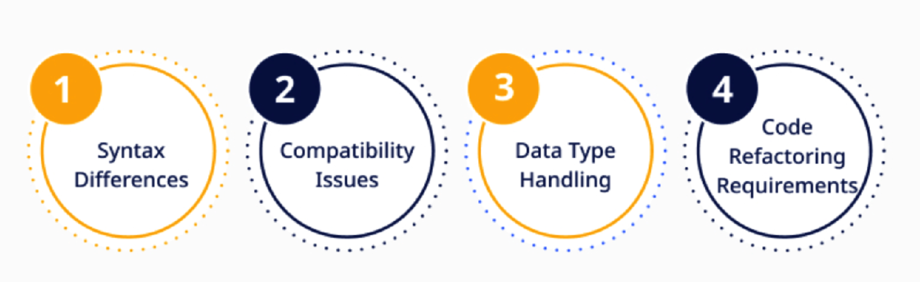
Upgrading Challenges
Challenges during the Upgrading of programming language

Slide 42
Automate Modernization Using GenAI

Slide 43
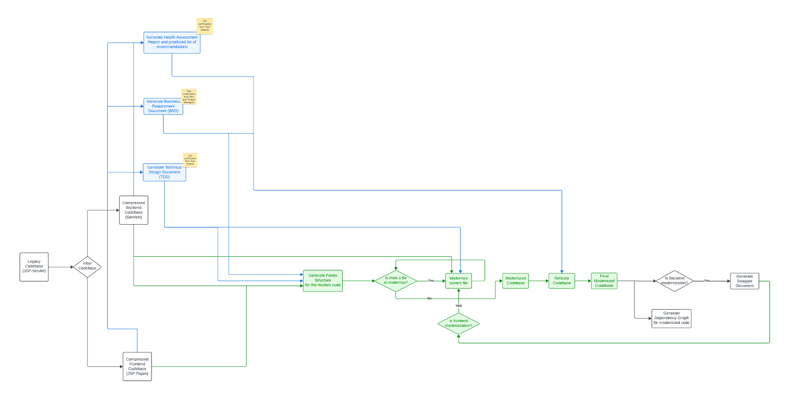
How it Works (Process Flow)

Slide 44
Framework Upgrade

Slide 45
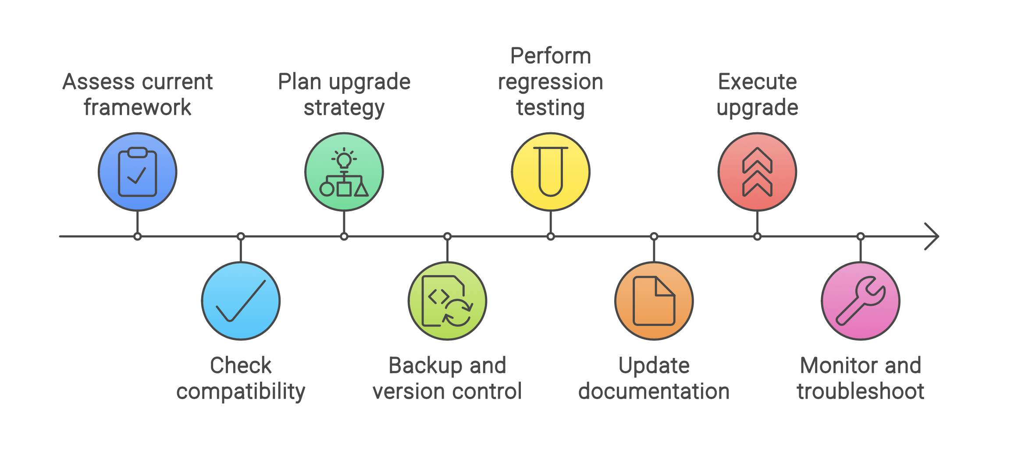
Framework Upgrade

Slide 46
Framework Upgrade Process
Pre-Upgrade Assessment
- Inventory of Components: List out all components, modules, and dependencies in the current framework version.
- Compatibility Check: Determine if the existing components are compatible with the new framework version.
Planning the Upgrade - Strategy: Decide whether to upgrade the entire application or specific parts incrementally.
- Backup and Version Control: Ensure all existing code is backed up and version-controlled before starting.
Post-Upgrade Activities - Regression Testing: Ensure that the upgrade hasn't introduced any bugs in the system.
- Documentation: Update any documentation to reflect the new framework version.

Slide 47
Use case: Upgrading Springboot 2.7 to Springboot 3.x

Slide 48
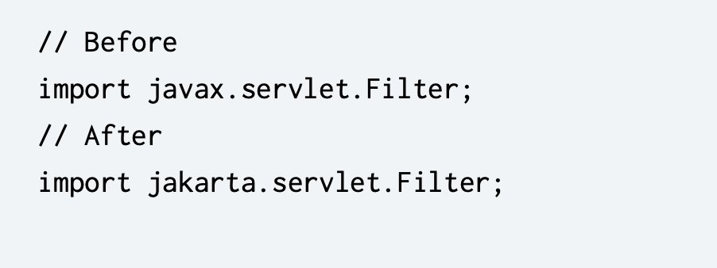
Upgrading to Spring Boot 3.0
Preparation Steps
Upgrade to 3.0: Before moving to 3.0, ensure your project is on Spring Boot 2.7.x. This step helps in minimizing issues.
Dependency Review: Ensure all dependencies are compatible with Spring Boot 3.0. Focus on libraries that have shifted from javax to jakarta.
Key Changes Overview Jakarta EE: Replace all javax.* imports with jakarta.*. This
change is necessary due to the adoption
of Jakarta EE 9 in Spring Boot 3.0.

Slide 49
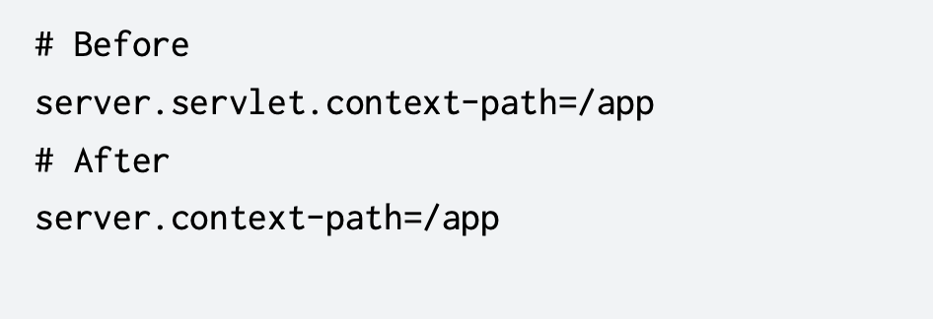
System Requirements:
Java 17+ is mandatory for Spring Boot 3.0.
Configuration Changes
Properties Migration:
Utilize the spring-boot-properties-migrator to handle deprecated properties.
Actuator Endpoints:
The httptrace endpoint is now renamed to httpexchanges.

Slide 50
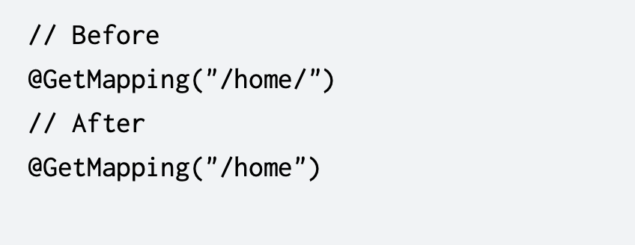
Web Application Adjustments
URL Matching:
Spring Boot 3.0 disables trailing slash matching by default.
HTTP Headers:
Use server.max-http-request-header-size for setting header size limits.

Slide 51
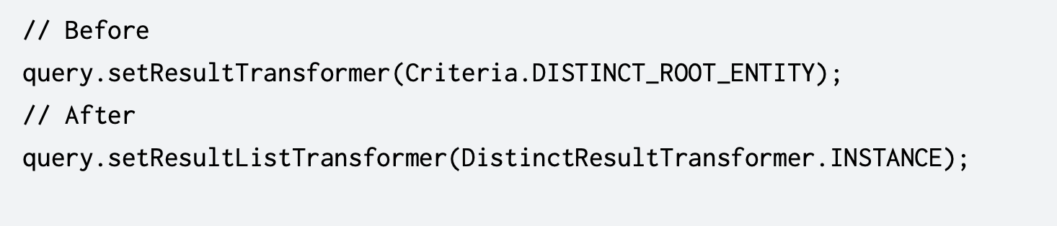
Data Access and ORM
Hibernate 6.1 Upgrade:
Review and adjust code that interacts with Hibernate, as there are changes in query
syntax and APIs.
Property Prefixes:
Update properties like spring.redis.* to new prefixes if they’ve changed.

Slide 52
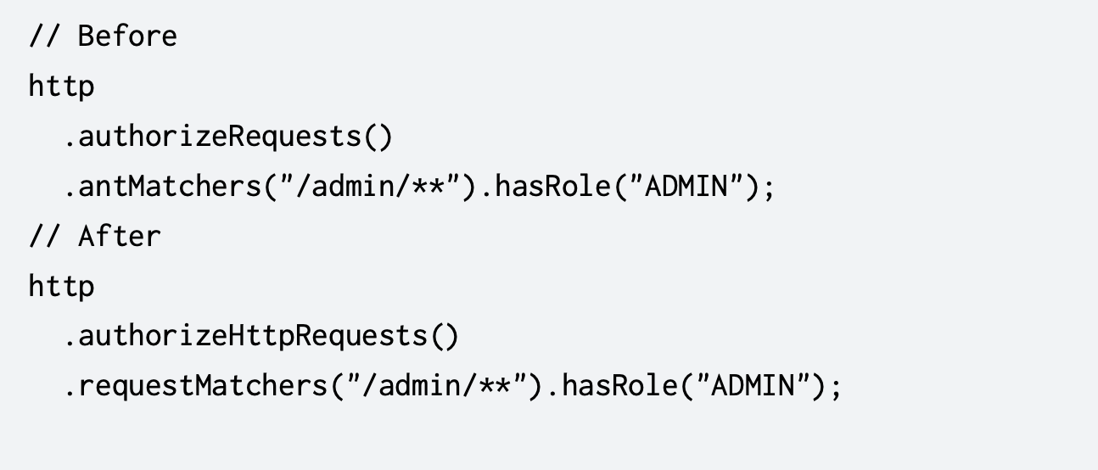
Spring Security Updates
Spring Security 6.0:
Review security configurations for
breaking changes.
Testing and Validation
Run Tests:
Ensure that all unit and integration tests pass after migration.
Validation Libraries:
Update any custom validators to use jakarta.validation instead of javax.validation.

Slide 53
AWS SDK Version Migration

Slide 54
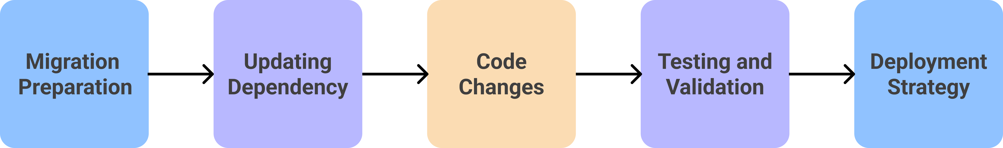
AWS SDK Version Migration
SDK migration refers to the process of updating or transitioning from one version of a Amazon Software Development Kit (SDK) to a newer version.
The migration process involves updating dependencies, refactoring code, and thoroughly testing the application to ensure a smooth transition.

Slide 55
Why SDK Version Migrations?

Slide 56
Benefits of SDK Version Migration
Enhanced Performance
Modern API Design
Improved Integration with AWS Services
Better Security

Slide 57
Steps to Migrate

Slide 58
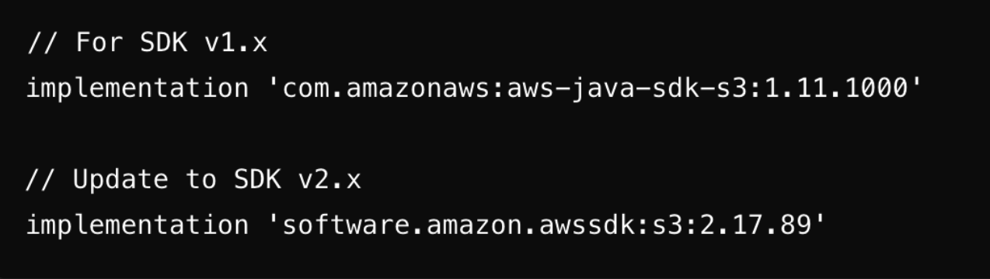
Migration Preparation
Review the project dependencies: Identify all dependencies that interact with the AWS SDK and check their compatibility.
Update the Maven/Gradle build scripts: Adjust your build scripts to incorporate the new SDK version.
Ensure third-party libraries compatibility: Verify that any third-party libraries you use are compatible with new SDK version.

Slide 59
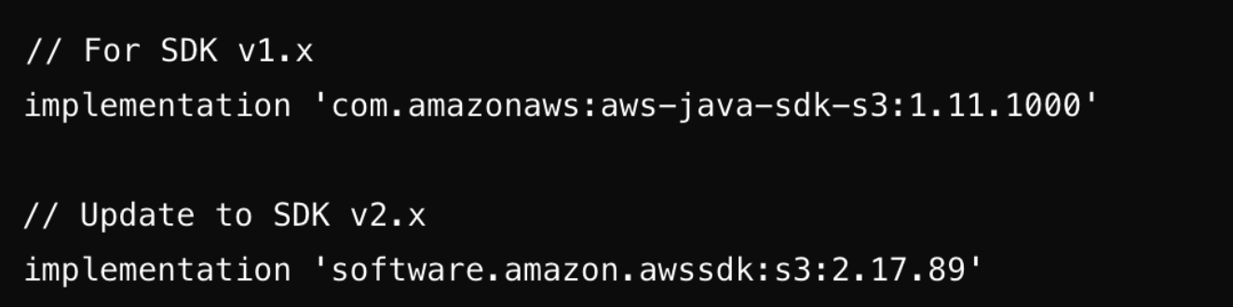
Updating Dependencies
Update the SDK version in build files: Modify your pom.xml (for Maven) or build.gradle (for Gradle) to use the latest version of AWS SDK for Java v2.x.
Replace any AWS SDK v1.x dependencies: Remove references to v1.x and replace them with the corresponding v2.x dependencies.

Slide 60
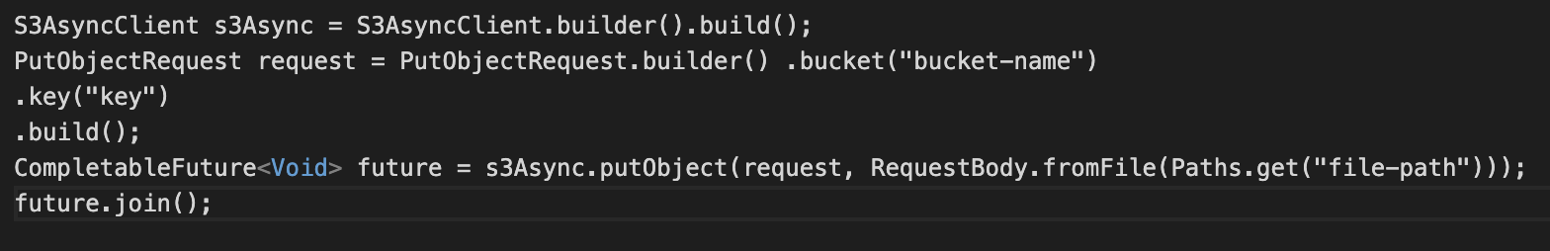
Code Changes
Refactor the code to utilize the new builder patterns and fluent interfaces introduced in newer SDK version.
Example:
For migrating SDK v1.x to SDK v2.x replace synchronous methods with asynchronous methods:
SDK v1.x Example (Synchronous):
SDK V2.x Example(Asynchronous):

Slide 61
Testing and Validation
Perform unit and integration testing: Conduct comprehensive testing of the application to verify that all functionality operates correctly with the updated SDK version.
Validate existing functionality: Ensure that the migration has not unintentionally disrupted any existing functionality.
Ensure proper integration with AWS services: Verify that your application integrates properly with the AWS services it utilizes.

Slide 62
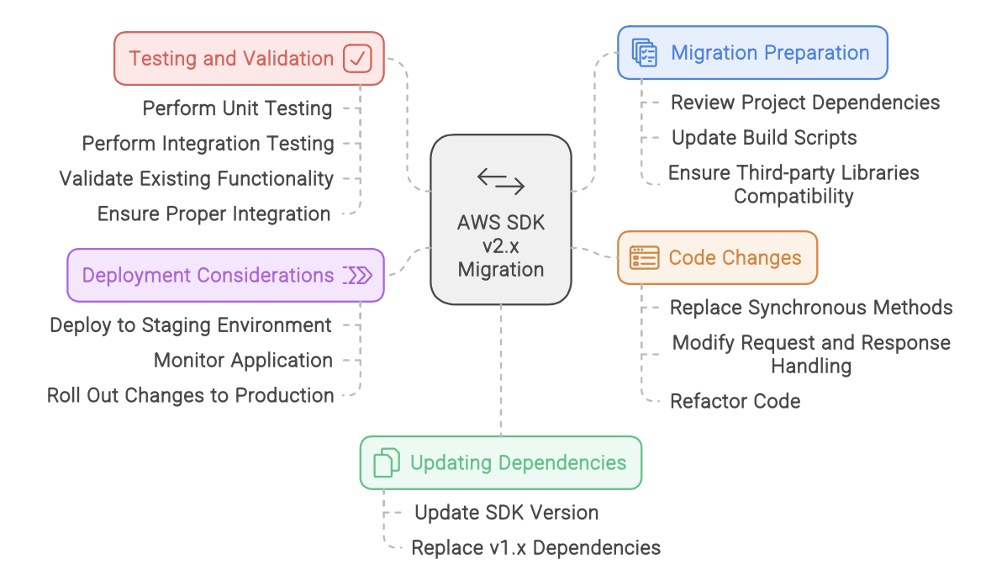
Deployment Considerations

Slide 63
Task

Slide 64
Task
Monolithic- Microservices Task -
Task Owner : Azeemushan Ali & ArunPrasanth
Create a 3 tier monolithic app which has Frontend-Backend-Database all tightly coupled in one, and then migrate that app to microservice architecture,using docker where frontend service will be public, both backend and database will be private and connecting with each other.
Repository Migration Task
Task Owner : SP & Sundar
Migrate the AWS CodeCommit Repository to the any Git Provider with all best practices ( GitHub/ Azure DevOps/ Gitlab, etc.,)
Programming Language Modernization/Migration Task:
Task Owner : Kishan Lal & ArunPrasanth
Your primary objective is to modernize the backend of the legacy ToDo App, currently implemented in JSP-Servlet. You may convert it to .NET, Java Spring Boot, or Python—whichever platform you are most comfortable with. If time permits, you can also work on modernizing the UI.
You can find the original project here: ToDo App on GitHub.

Slide 65
Q & A

Slide 66
Thank You

